Slide 1


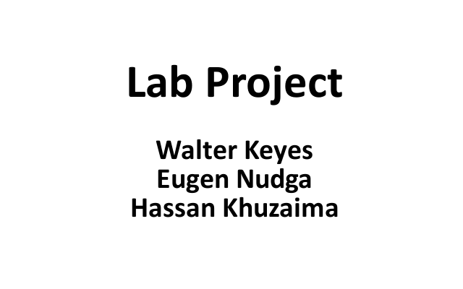

Slide 2
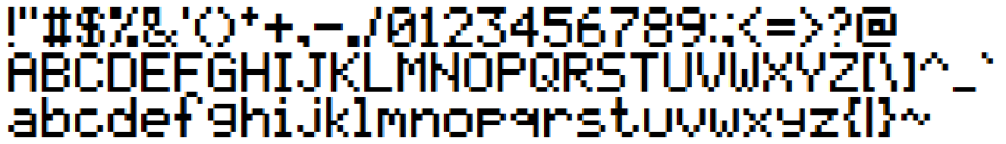
Project Description
Text to appear on LED pendulum? Enter text on the console.
Up to 10 characters (letters, numbers and special characters)
Invert color? Push the button.
UART and button have interrupt handlers

Slide 3
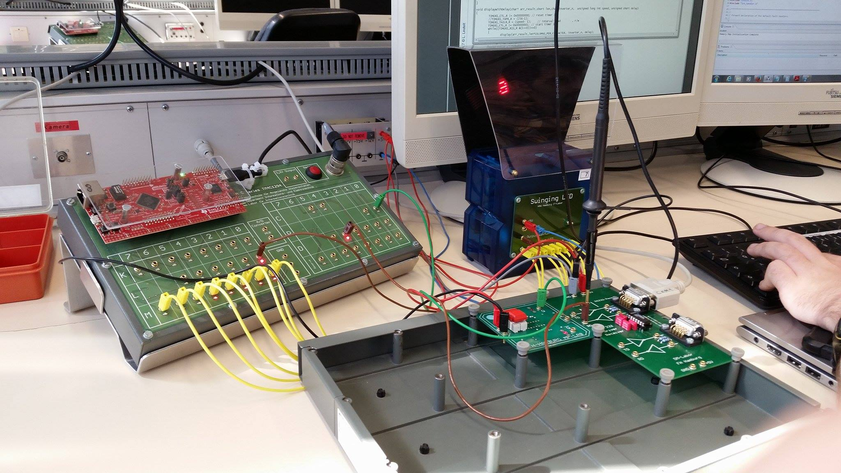
Work Plan:
Walter: Functions to configure the UART module
Hassan: Function to read the values from the UART
Eugen: Interrupt handler for the pushbutton

Slide 4
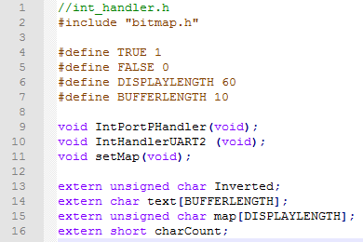
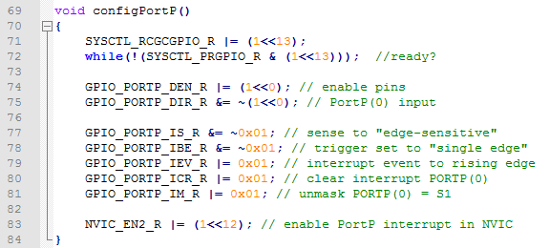
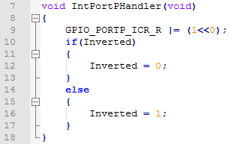
Eugen: Interrupt handler for the pushbutton

Slide 5
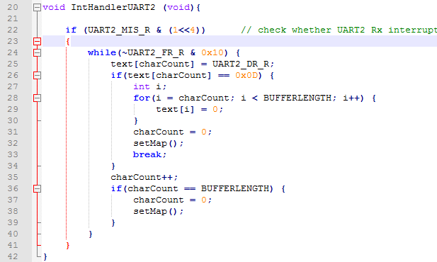
Hassan: Function to read the values from the UART

Slide 6
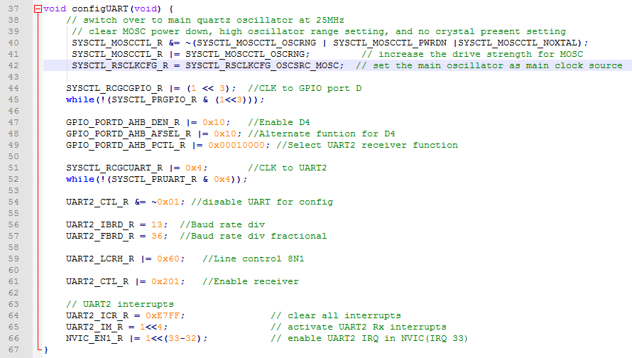
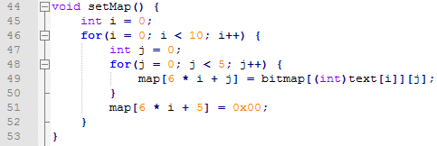
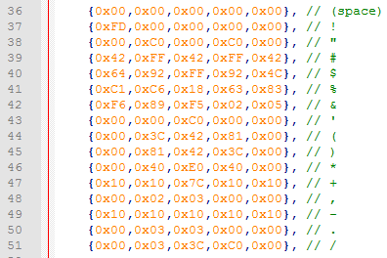
Walter: Functions to configure the UART module and bitmap

Slide 7


